Slide 1
Polymer Enclosure with Wire Passthrough for Implantable Device
Neuralink, US 2023/0148968 A1, Published 5/18/2023
6/17/2024

Slide 2
Background
Implantable devices in-vivo have rigid hermetic housing to protect active electronics from environmental and mechanical stress
Increasingly common for large number (e.g., thousands) of tightly-spaced (micron-level spaced) wires extending from implantable device
Traditional housing materials (ceramic, glass, titanium) can become problematic with above structure (e.g., cracked glass housing)

Slide 3
Outline
Goal: Describe a method and disclosure for manufacturing polymer (PCTFE) enclosure with polymer (PI) wires extending through a passthrough slit for implantable devices + reflowing process to form substantially hermetic seal around wires
Purpose of invention: To prevent bending or straining of wires and allow the use in relatively high temperatures and pressure to ensure substantially hermetic seal.
Embodiments:
Implantable Device with Polymer Enclosure with Bottom Passthrough Slit
Components of Enclosure
Piece of Polymer Before and During Slit Fabrication
Piece of Polymer with Insulated Wires Inserted in Slit
Portion of Enclosure Placed in Mold for Sealing
Piece of Polymer Placed in Mold Base for Sealing
Clamp for Sealing Passthrough Slit
Heater for Sealing Passthrough Slit
First View of Mold for Manufacturing a Polymer Enclosure
Second View of Mold for Manufacturing a Polymer Enclosure, with Wires in Place
Mold for Manufacturing a Polymer Enclosure, with Wires and Stiffener in Place
Flowchart for Manufacturing Enclosure with Passthrough Slit
Computer System

Slide 4
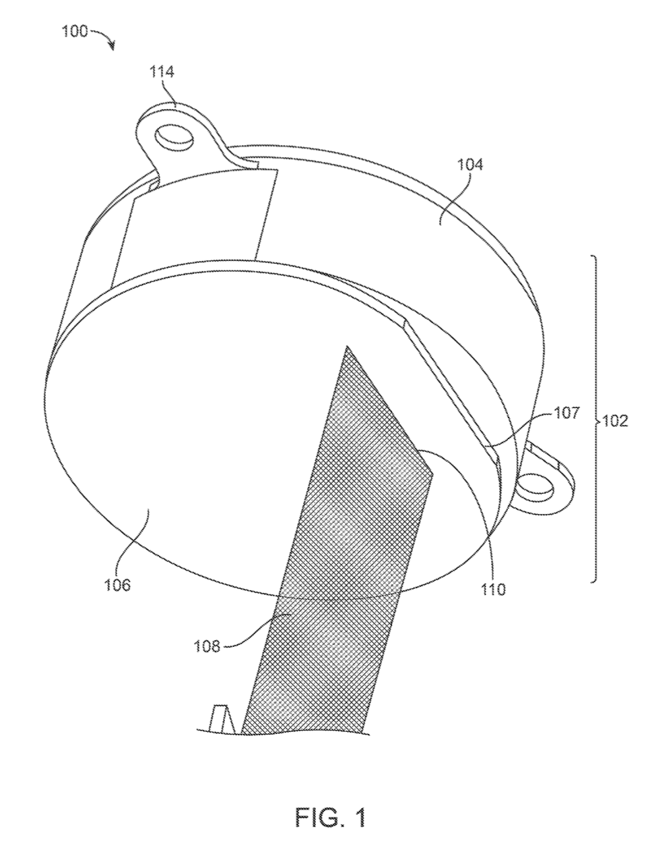
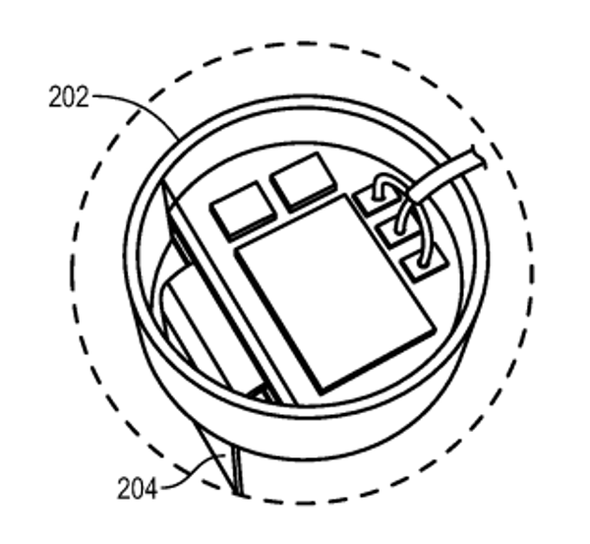
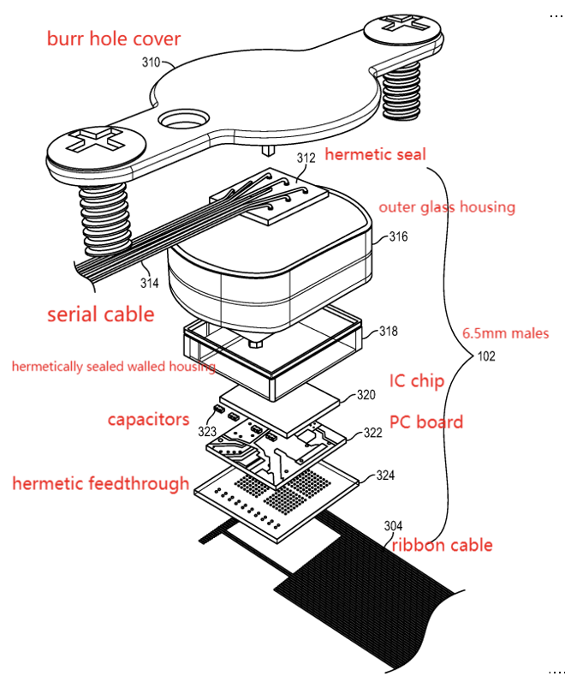
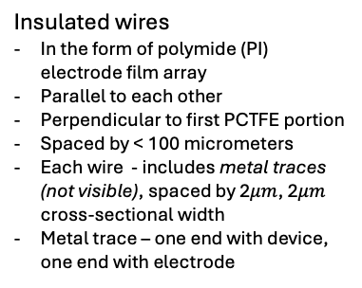


Implantable Device with Polymer Enclosure with Bottom Passthrough Slit
Attachment means
Second piece of polymer (top portion; PCTFE)
Edge
Enclosure
First piece of polymer (bottom portion; PCTFE)
Insulated wires
In the form of polymide (PI) electrode film array
Parallel to each other
Perpendicular to first PCTFE portion
Spaced by < 100 micrometers
Each wire - includes metal traces (not visible), spaced by 2$μm$, 2$μm$ cross-sectional width
Metal trace – one end with device, one end with electrode
Slit
* Inside the structure (sealed): IC chip, communications components (wireless, bluetooth), power components (wireless charging)

Slide 5
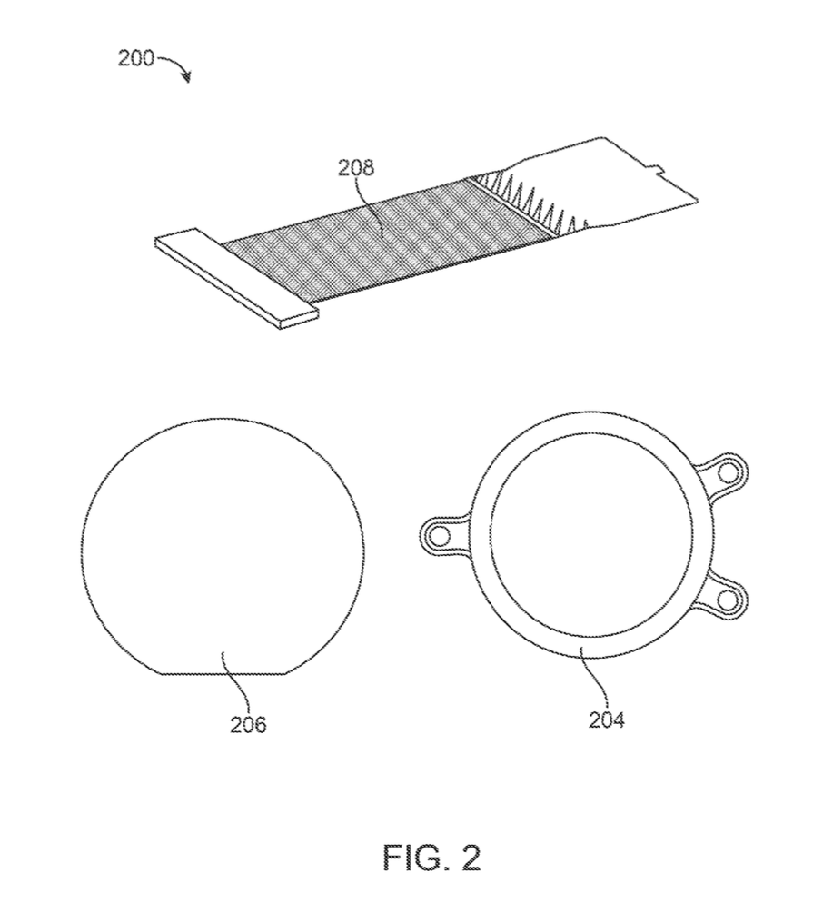
Components of Enclosure
Insulated wires
First piece of polymer
Second piece of polymer

Slide 6
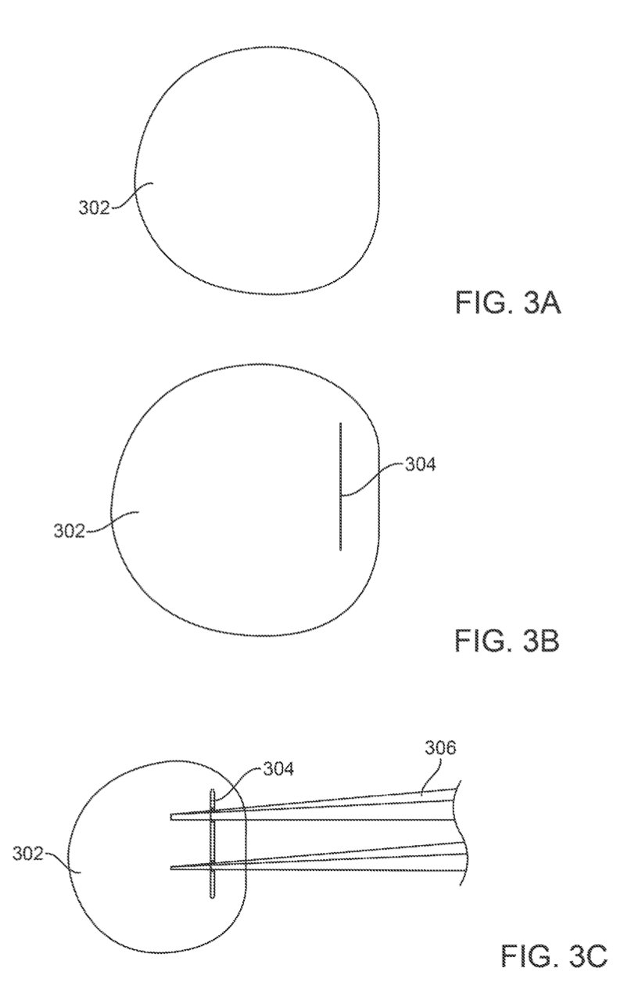
Piece of Polymer in Slit Fabrication Process
Forceps / tweezers
Slit
Piece of polymer (PCTFE)
Before
slit fabrication
(initial piece of PCTFE provided)
During
slit fabrication
(slit formed via knife or blade, cut may be partial or completely separating)
During
slit fabrication
(slit widened via tweezers/forceps to accommodate wires, then sanded/smoothed to prevent damage)

Slide 7
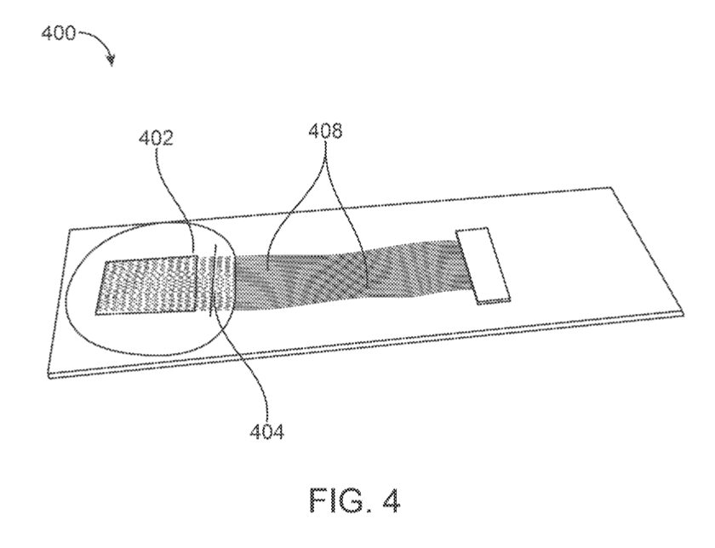
Piece of Polymer with Insulated Wires Inserted in Slit
Wires (pass through slit, annealed at temperature < 100C)
Piece of polymer
Slit

Slide 8
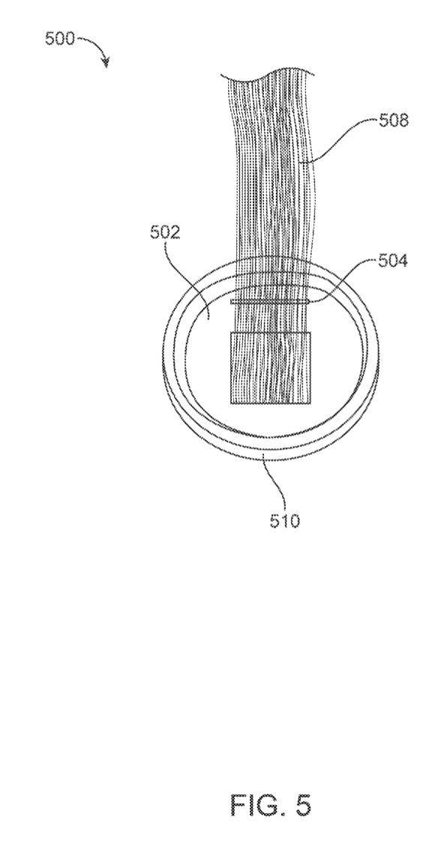
Portion of Enclosure Placed in Mold for Sealing
Insulated wires
Piece of polymer (PCTFE)
Slit
Mold Base
(PCTFE fits snugly inside mold base, facilitate reflow of PCTFE to seal around wires)

Slide 9
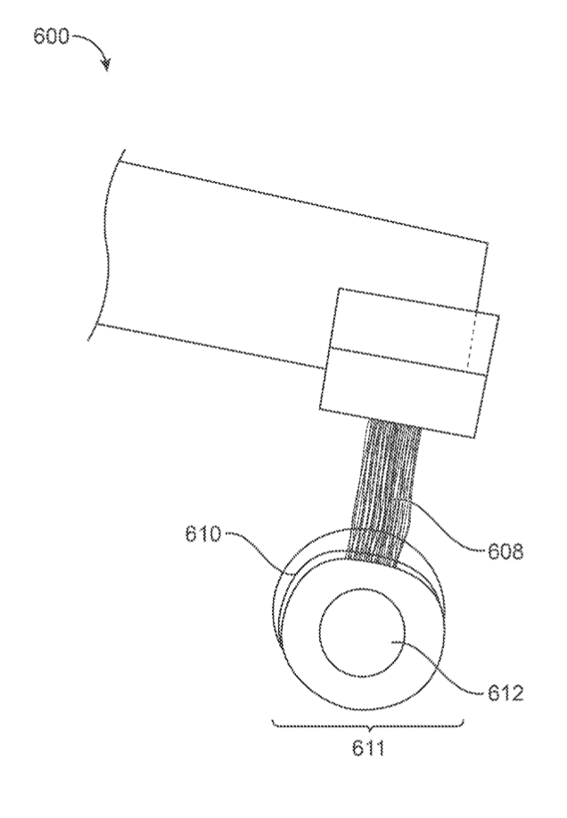
Piece of Polymer Placed in Mold Base for Sealing
Mold Base
Insulated wires
Mold Top
PCTFE (not visible) enclosed within mold
Mold
made of metal or other rigid material that does not decompose, deform, or react chemically with polymer at reflow temperature/pressure
Follow outline pattern of PCTFE to fit PCTFE snugly (PCTFE does not move around)

Slide 10
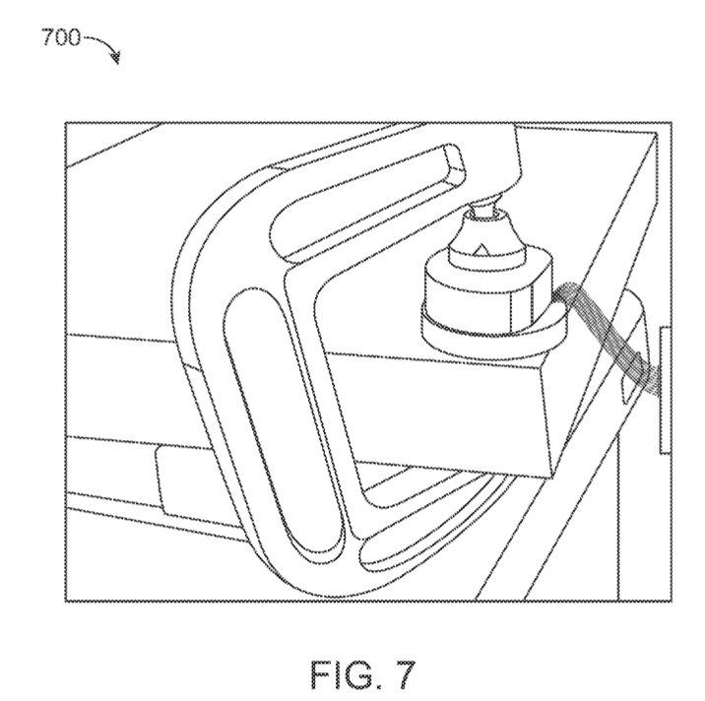
Clamp for Sealing Passthrough Slit
Clamp:
- Used to apply pressure to portion with slit & insulated wires for thermocompression
- C-clamp shown

Slide 11
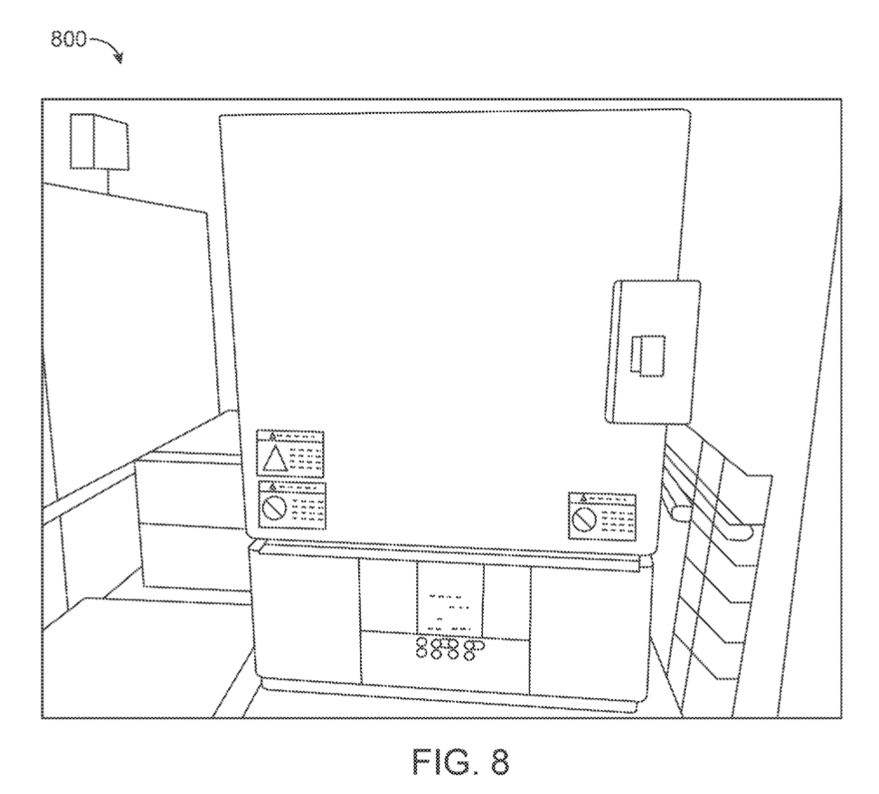
Heater for Sealing Passthrough Slit
Heater:
- Used to apply heat to portion with slit & insulated wires for thermocompression
- Furnace – heat to 200-400C

Slide 12
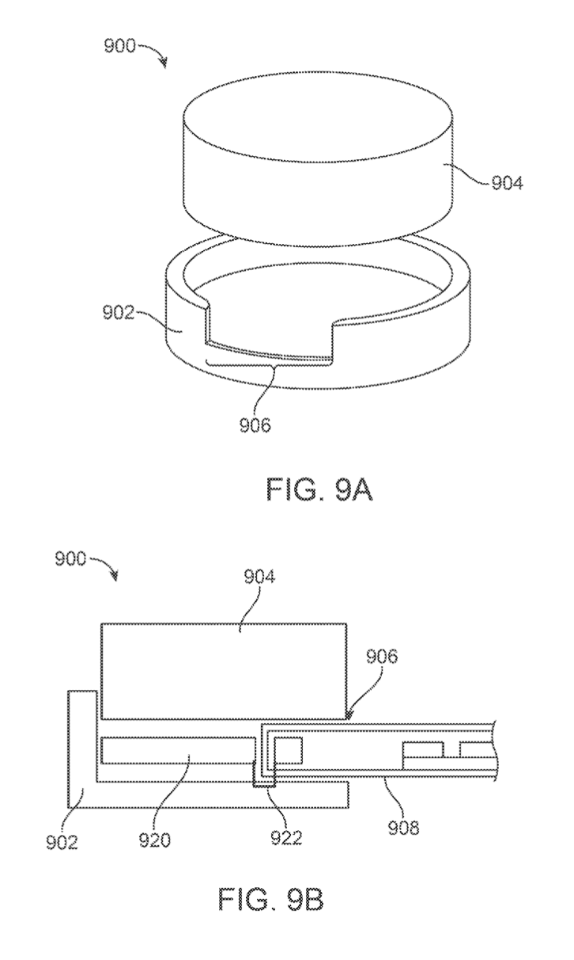
First View of Mold for Manufacturing a Polymer Enclosure
Mold Top
Mold Base
(polymer reflows within mold)
Opening
(where wires extend out)

Slide 13
Second View of Mold for Manufacturing a Polymer Enclosure, with Wires in Place
Electrode region
Mold Top
Opening
Bond pad region
Wires
If wires are pre-connected to electronics before slit formation → bond pad OUTSIDE of mold (prevent damage to electronics)
Mold Base
Piece of polymer
Melt zone

Slide 14
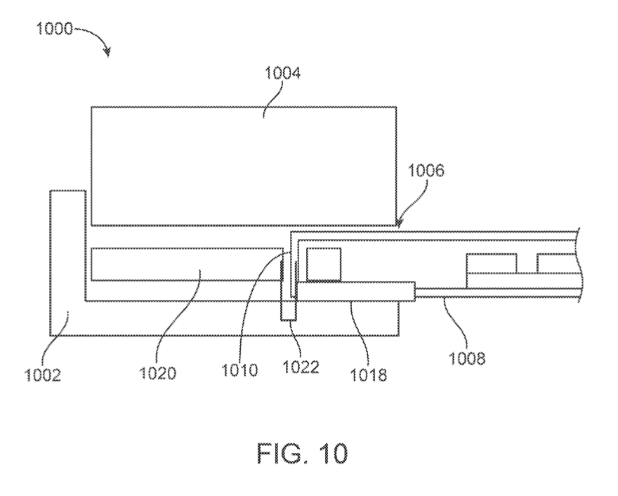
Mold for Manufacturing a Polymer Enclosure, with Wires and Stiffener in Place
Mold Top
Opening
Melt zone
Wires
Mold Base
Piece of polymer
Stiffener
Placed between polymer & mold
Temporarily support wires during sealing
Protect wires from damage
Maintain alignment of wires
Made of Kapton (polymide film type)

Slide 15
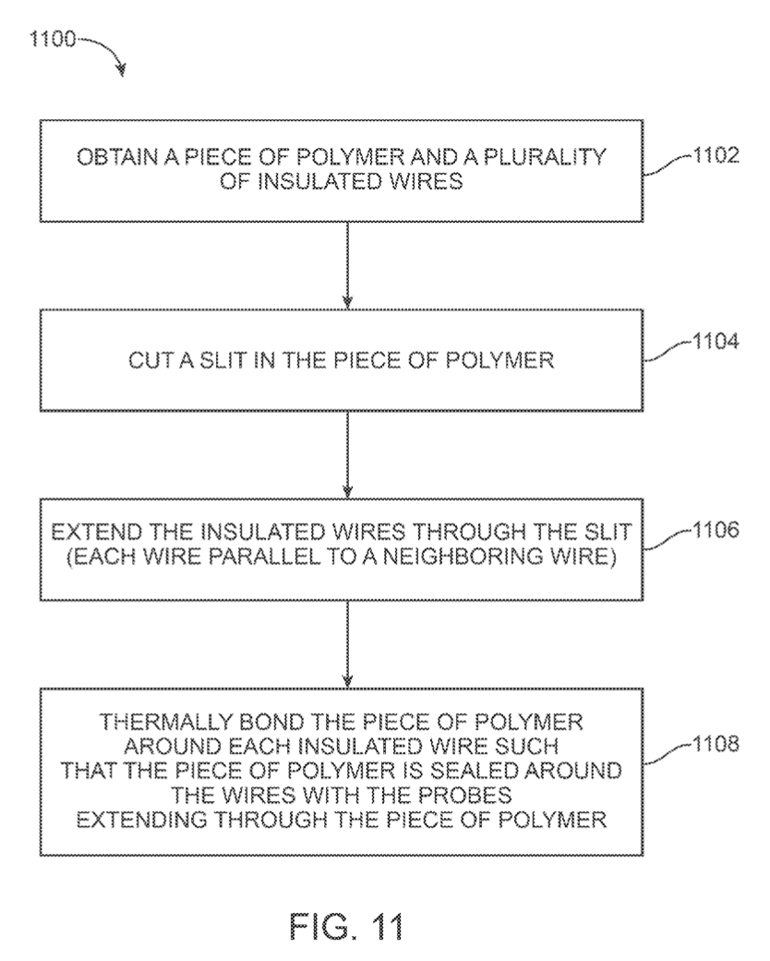
Flowchart for Manufacturing Enclosure with Passthrough Slit

Slide 16
Step 1:
Insulated wires
Piece of polymer

Slide 17
Step 2:
Forceps/Tweezers
Slit
Piece of polymer
Form slit via knife/blade
Widen slit via forceps, then sand down to accommodate wires

Slide 18
Step 3:
Mold Top
Piece of polymer
Wires
Opening
Melt zone
Wires
Slit
Mold Base
Piece of polymer
Stiffener

Slide 19
Step 4:
Use thermo-compression techniques for thermal bonding PCTFE (performed automatically in controller)
Seal slit around wires
Apply pressure on polymer piece + insulated wires on the slit portion via clamp (or hydraulic press/piston)
Heat polymer + wires via furnace (or hot plate) – melt polymer without damaging wires (250-300C for PCTFE polymer piece for reflow + fusing around PI wires, 10-15 minutes)
Higher pressure, time, temperature of thermocompression → more PCTFE melt
Deactivate heater & clamping devices from mold
Dispose active electronics within 2 polymer pieces
Join 2 polymer pieces to form enclosure (similar to step 1, but set max temperature to 255-260C)
Cool implantable device (sealing system sets alarm to notify user of completion)
* reflow: join metals/polymers together by heating and melting solder
Clamp
Heater

Slide 20
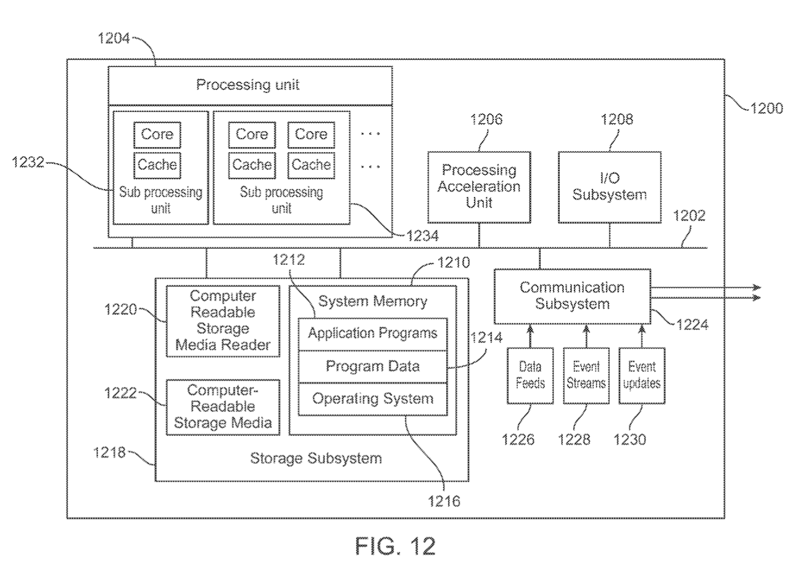
Computer System

